Slide 1

IMAGE FORGERY AND RUMOUR DETECTION
TEAM MEMBERS:
SHREYASEE SARKAR
MOITRYEYEE DAS
AHONA ROYCHOUDHURY

Slide 2
CONTENT
INTRODUCTION
PROBLEM STATEMENT/REQUIREMENT SPECIFICATION
RUMOUR DETECTION
IMAGE FORGERY

Slide 3

Fake images and rumors are everywhere online, making it hard to know what's real.
This hurts trust and makes it confusing to find good information.
We use special tools to find fake images and stop rumors from spreading.
This helps people make better decisions online.
INTRODUCTION

Slide 4

PROBLEM STATEMENT
There has been chaos these days since there is a lot of image forgery and fake news spreading
around the world. The internet users are unable to detect what to trust and what not to. They
believe in what they see and this way rumors spread.
So through this project we are trying to help the users to detect fake news or links and
photoshopped images. We believe that this project will be of great assistance to the users and
they will not be fooled or trolled by the unethical users who try to spread fake news or try to
profit themselves by the loss of some person
.

Slide 5

FAKE NEWS
DETECTION

Slide 6
Program Flow:
3.Trains the four machine learning classifiers.
2.Creates TF-IDF vectors for news titles.
Loads true and fake news datasets.
5.Sets up a Flask web server with an endpoint /check_news to handle news classification requests.
4.Defines a function classify_news to classify new news articles
Converts input news title to lowercase.
Creates TF-IDF vector for the new title.
Uses each classifier to make a prediction.
Returns the majority vote prediction and additional information (text, date, etc.).

Slide 7
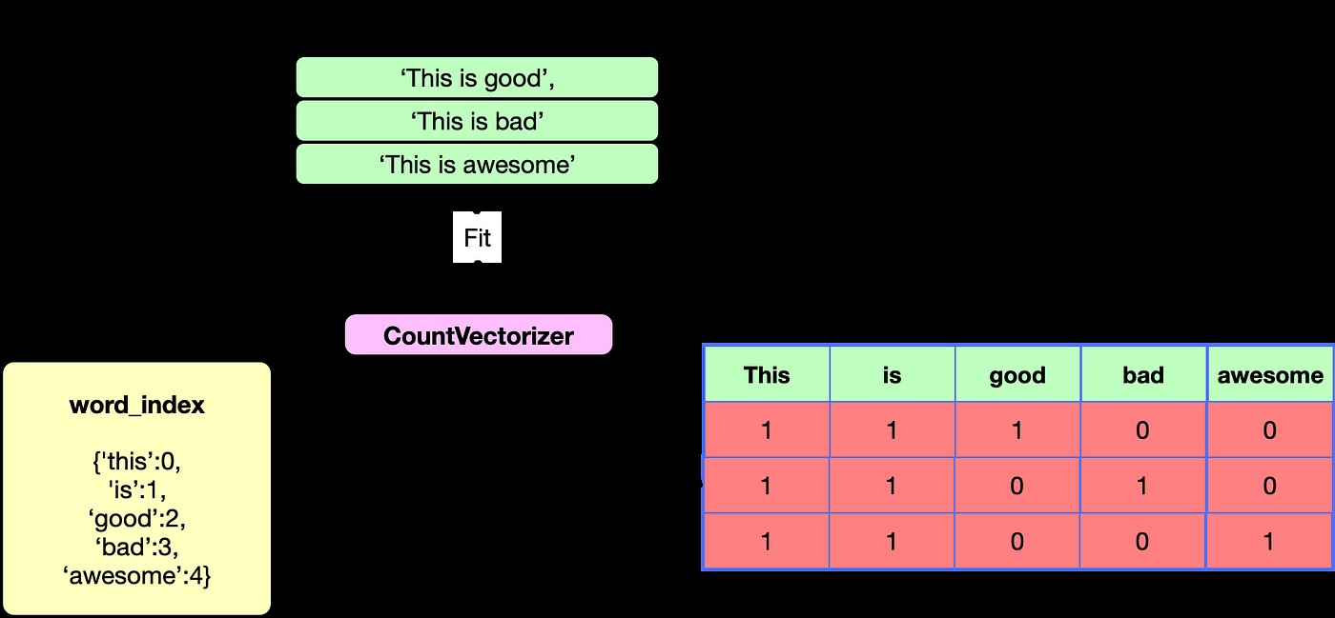
1. TF-IDF (Term Frequency-Inverse Document Frequency) Vectorizer:
TF-IDF (Term Frequency-Inverse Document Frequency) Vectorizer bridges the gap between textual data and machine learning algorithms.
It works in two parts:
1.Term Frequency (TF): This measures how often a word appears in a specific document (news title). Words that show up more frequently are considered more important for that particular document.
2.Inverse Document Frequency (IDF): This considers how common a word is across all documents in the dataset (all news titles). If a word appears very frequently across all documents, it becomes less informative for distinguishing a specific document. The IDF reduces the weight of such common words.
Why is TF-IDF Vectorizer Useful Here?
By combining these two aspects, TF-IDF effectively captures the significance of words within a document relative to the entire document collection.
In this program, TF-IDF helps identify words that are:
Distinctive: Words that appear frequently within a news title but are uncommon in other
titles ( high TF and high IDF) become crucial for understanding that specific news.
Meaningful: Less frequent words within a title but uncommon across all titles
(low TF and hiIDF) can also hold significance.

Slide 8
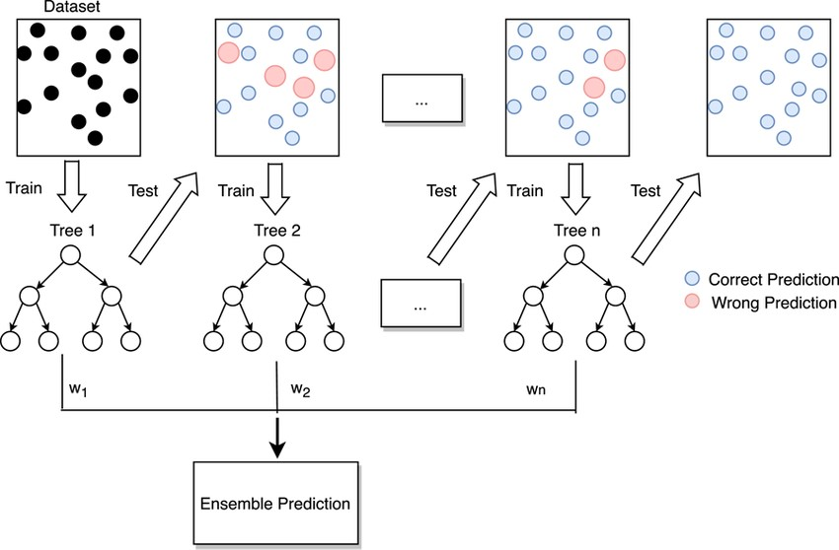
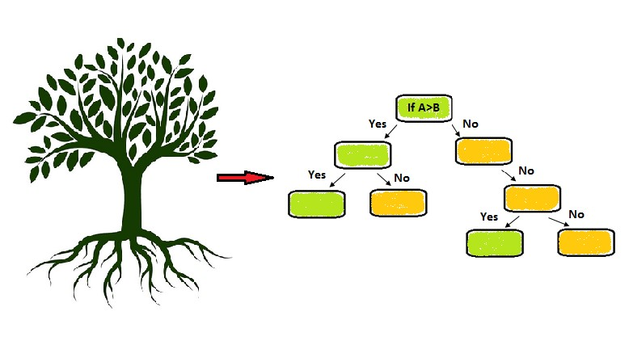
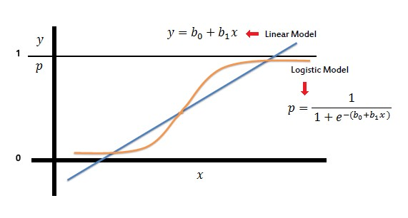
CLASSIFIER/REGRESSOR
Ensemble Classifiers
Decision Tree Classifier:
Logistic Regression:
These classifiers are robust to noise and can handle complex patterns in the data.
By combining multiple, weaker decision trees, they can often achieve better accuracy than a single classifier.
In the context of news classification, they can effectively learn the subtle differences between factual and fabricated language patterns.
It offers an advantage in interpretability. You can understand the decision-making process of the model by following the splits in the tree.
This can be helpful for analyzing why a particular news article is classified as fake or real
It provides a probabilistic output, indicating the likelihood of a news article being fake or real. This can be more informative than just a binary classification (fake/real).

Slide 9

IMAGE FORGERY

Slide 10
PROGRAM FLOW
Import Libraries: The program imports necessary libraries for GUI development, image processing, file handling, and forgery detection.
Global Variables: Sets global variables for image width, height, and initializes the uploaded image variable.
Function Definitions: Defines various functions for different image analysis tasks such as browsing files, copy-move forgery detection, metadata analysis, noise variance inconsistency detection, CFA artifact detection, ELA analysis, JPEG compression detection, image decoding, and string analysis.
Initialization: Initializes the Tkinter window with the title "Copy-Move Detector" and sets its icon.
Label Display: Displays the label for the result of the scan and initializes panels for displaying input, middle, and output images.
Button Setup: Configures buttons for uploading images and running different detection algorithms.
Button Actions: Associates each button with its corresponding detection algorithm function.
Main Loop: Starts the main loop for the Tkinter window, which keeps the GUI running and responsive to user interactions.
User Interaction: Users can upload images, choose which detection algorithm to run, and view the results displayed in the GUI.
Program Termination: The program terminates gracefully when the user exits or closes the window.

Slide 11
IMAGE FROGERY ALGORITHMS
Event Handling Algorithms:
This algorithm detects when a user clicks button on the GUI. In this program, clicking a button triggers a specific function to run, such as uploading an image, or running a forgery detection algorithm. (Likely used throughout the button definitions)
Image Processing Algorithms:
Resizing: This algorithm resizes an image to a specific width and height. The program uses this algorithm to scale uploaded images to a consistent size for display within the user interface. (Function: getImage)
1
2
Graphical User Interface (GUI) Algorithms:
File Traversal Algorithms:
Directory Traversal: This algorithm is likely used to locate the image files used by the program, such as the input images, output images, and icons. (Not explicitly shown in the code snippet, but likely used).
3
4
Widget Layout: This algorithm arranges the various graphical elements (buttons, labels, progress bars, etc.) on the screen in a visually appealing and functional manner. (Likely used in the initialization of the Tkinter root window)

Slide 12
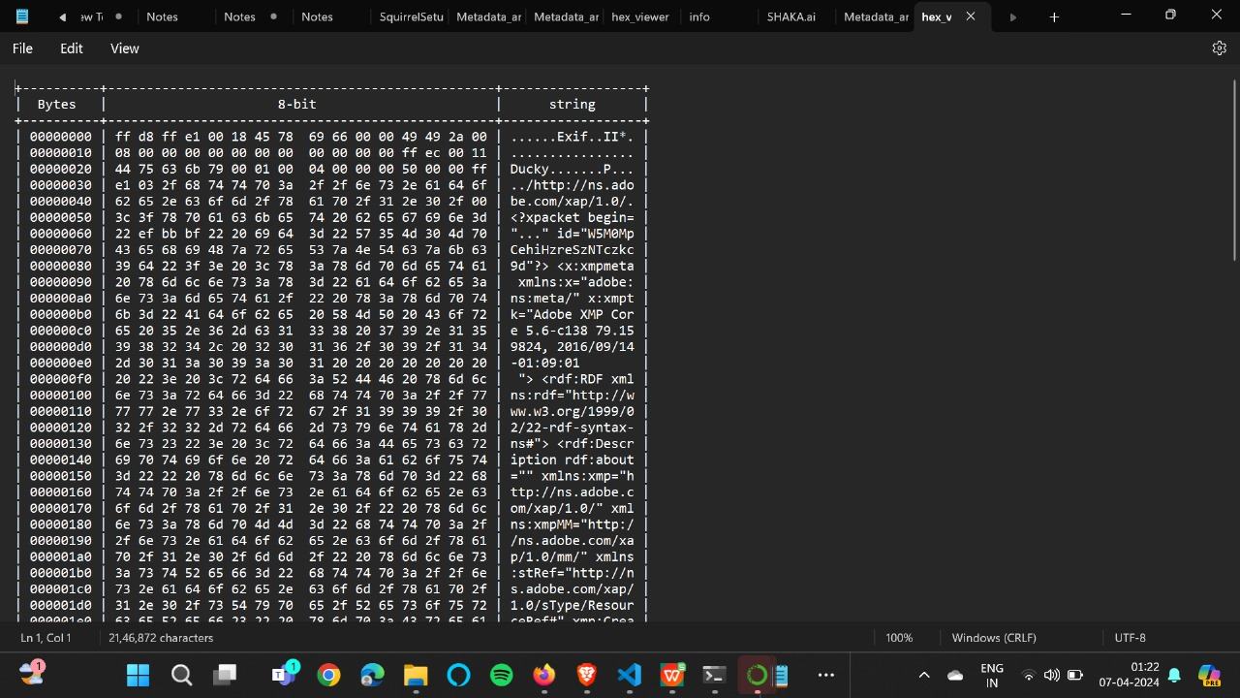
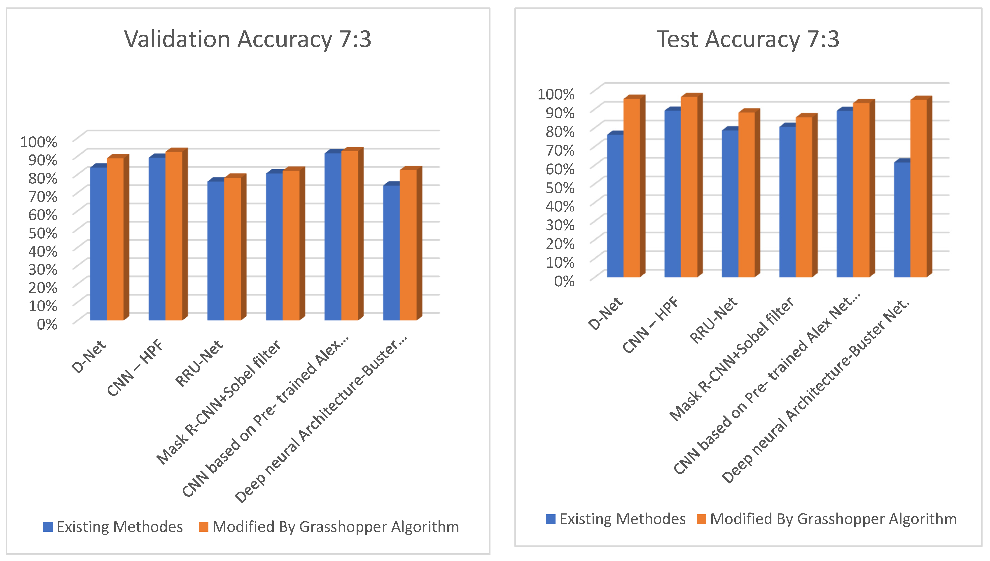
IMAGE FROGERY ALGORITHM ALGORITHMS
Hex View: This algorithm converts the raw bytes of an image file into hexadecimal representation and displays it alongside the corresponding ASCII characters. This can be useful for forensic analysis of the image data. (Function: string_analysis)
Progress Bar Update: This algorithm updates the progress bar to visually indicate the progress of a long-running task, such as image forgery detection. (Likely used in the various detection functions)
It's important to note that the specific implementation

Slide 13
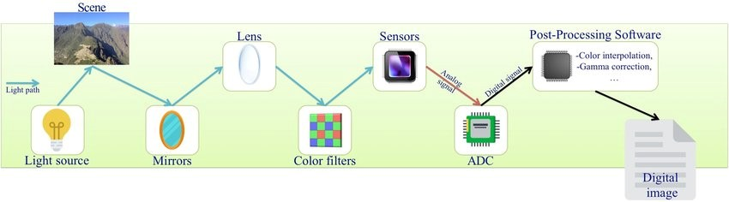
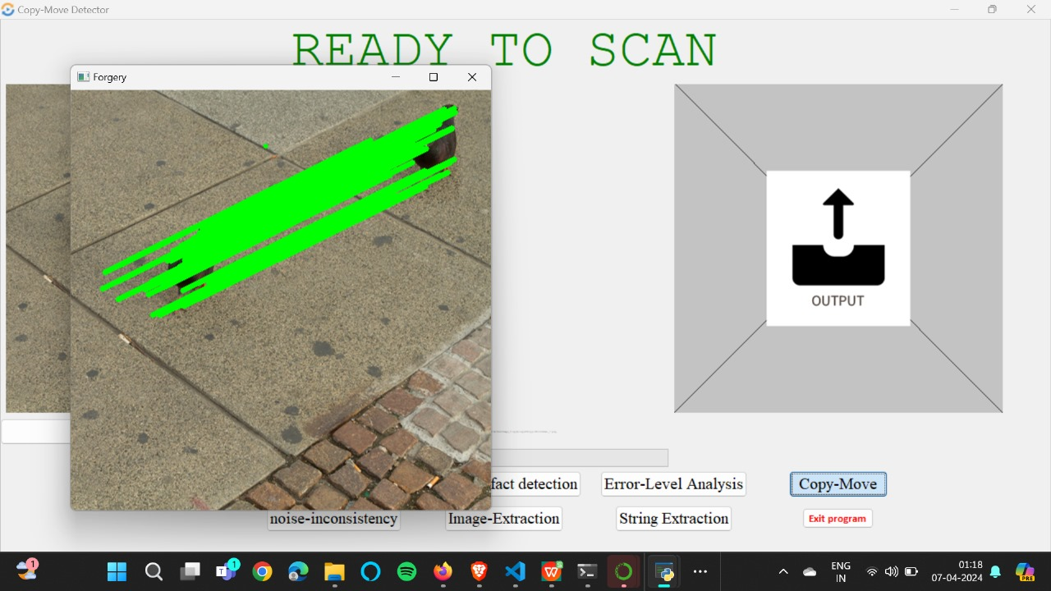
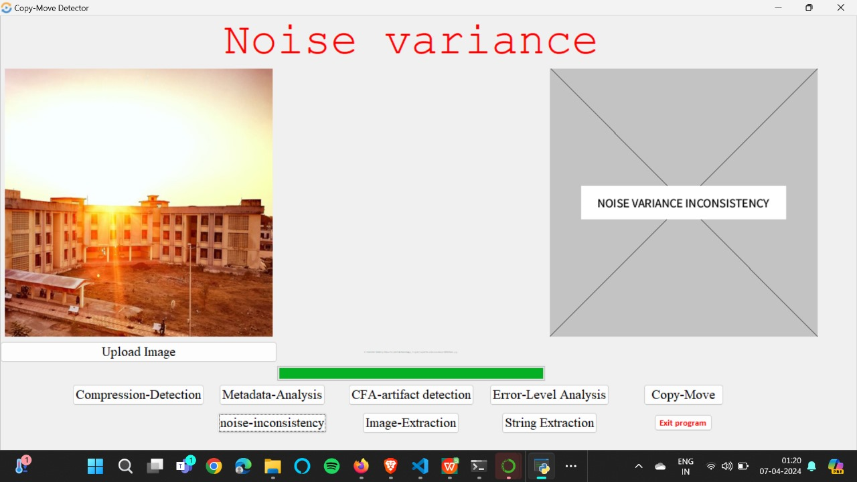
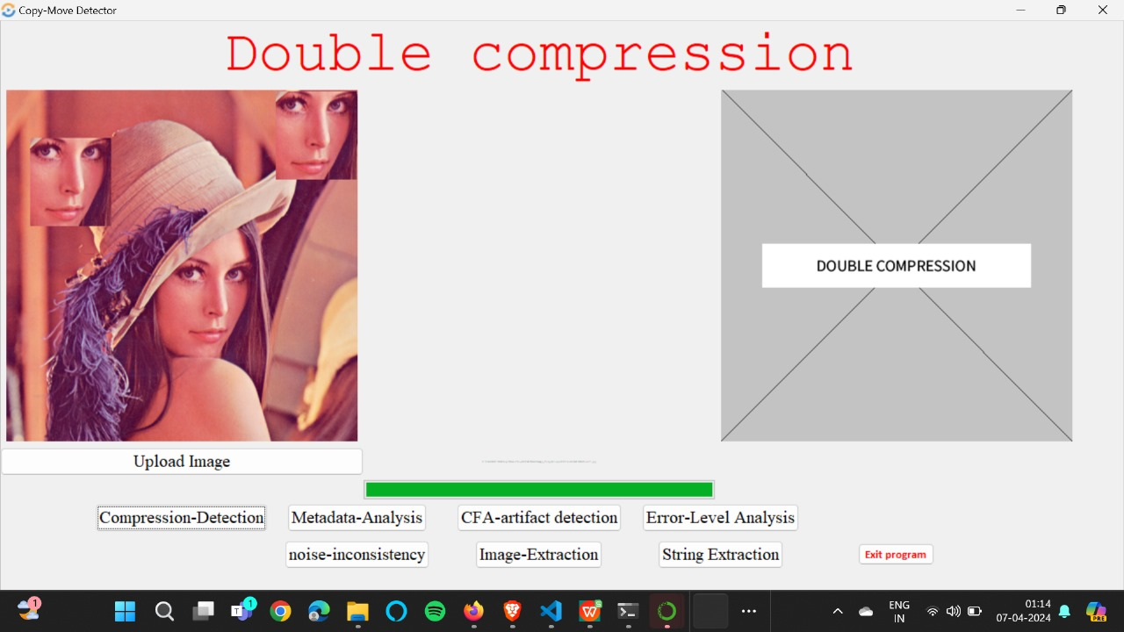
IMAGE DETECTION FUNCTIONS
Noise Variance Inconsistency Detection
CFA Artifact Detection
Button Click Detection
JPEG Compression Detection
This algorithm is used to identify regions of an image that have been copied and pasted from another part of the image, or from a different image altogether. (Function: copy_move_forgery)
This algorithm analyzes the statistical properties of the noise in an image to identify potential forgeries. Images that have been tampered with may exhibit inconsistencies in the noise
This algorithm is specifically designed to detect forgeries in images captured by devices with Color Filter Arrays (CFAs). These artifacts can be indicative of image manipulation. (Function: cfa_artifact)
This algorithm analyzes an image to determine if it has been compressed multiple times. Multiple compressions can be a sign of tampering. (Function: jpeg_Compression)

Slide 14


